Slide 1
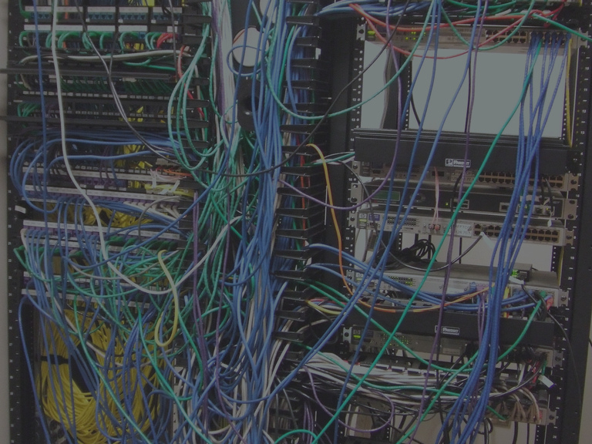
“Every phase of the mental activity of the country is more or less represented in this great system. The fluctuations in the markets; the price of stocks; bargains offered and bargains closed; sermons, lectures and political speeches; fires, sickness and death; weather reports; the congratulations of friends – every thing has its turn in passing the wires.”
Notes:
Every phase of the mental activity of the country is more or less represented in this great system. The fluctuations in the markets; the price of stocks; bargains offered and bargains closed; sermons, lectures and political speeches; fires, sickness and death; weather reports; the congratulations of friends – every thing has its turn in passing the wires

Slide 2
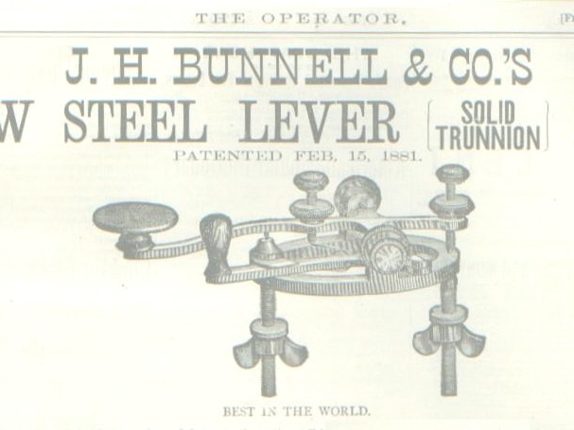
“Every phase of the mental activity of the country is more or less represented in this great system. The fluctuations in the markets; the price of stocks; bargains offered and bargains closed; sermons, lectures and political speeches; fires, sickness and death; weather reports; the congratulations of friends – every thing has its turn in passing the wires.”
—Harpers New Monthly Magazine, 1873
Notes:
Harpers New Monthly Magazine, 1873

Slide 3
History of Networking
The Victorian Internet
Notes:
Societies have been desperate for faster communication since there have been societies. Arguably, communication is what makes a society; faster communication lets the society be larger, more prosperous, more cohesive.
Our story begins February of 1825, with a woman named Lucretia. A wife and mother living in New Haven, Connecticut, she fell ill one day, as often happened back then. Word was sent right away to her husband, a portrait painter 212 miles away in New York on a commission. The message was sent by the fastest means possible, the same means for the past four thousand years: horseback. By the time the letter reached her husband a week later, Lucretia was already dead and buried; Samuel—that was his name, Samuel—arrived home a week after that.

Slide 4

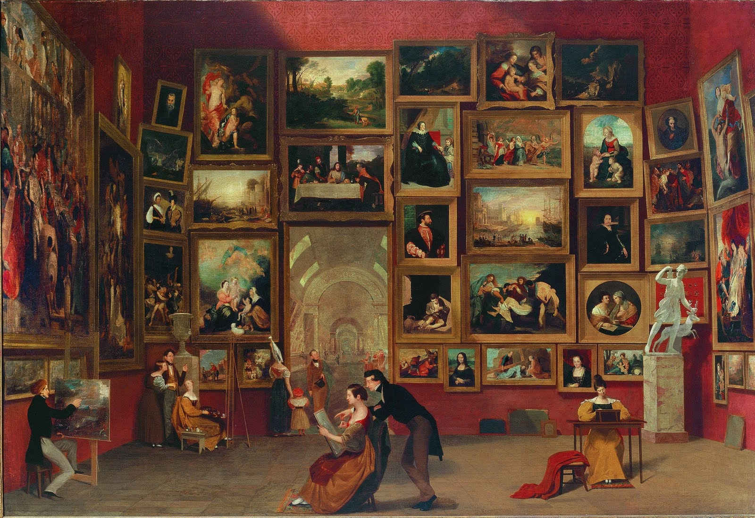
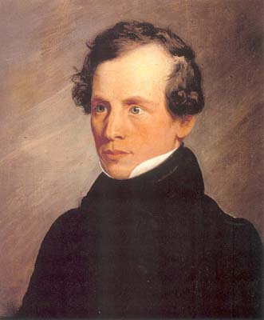
The Gallery of the Louvre (Samuel Morse, 1831)
Notes:
Skip forward seven years. Samuel Morse was sailing back to the US from Europe, where he’d painted this among other things. One night on the ship, he struck up conversation with Dr. Charles Jackson, a naturalist, who introduced him to the relatively new science of electromagnetism. From that moment, Morse became obsessed with sending messages this way. We don’t know he was thinking of that terrible February of 1825… but we do know he was thinking of Lucretia, because that’s her in the painting there.

Slide 5
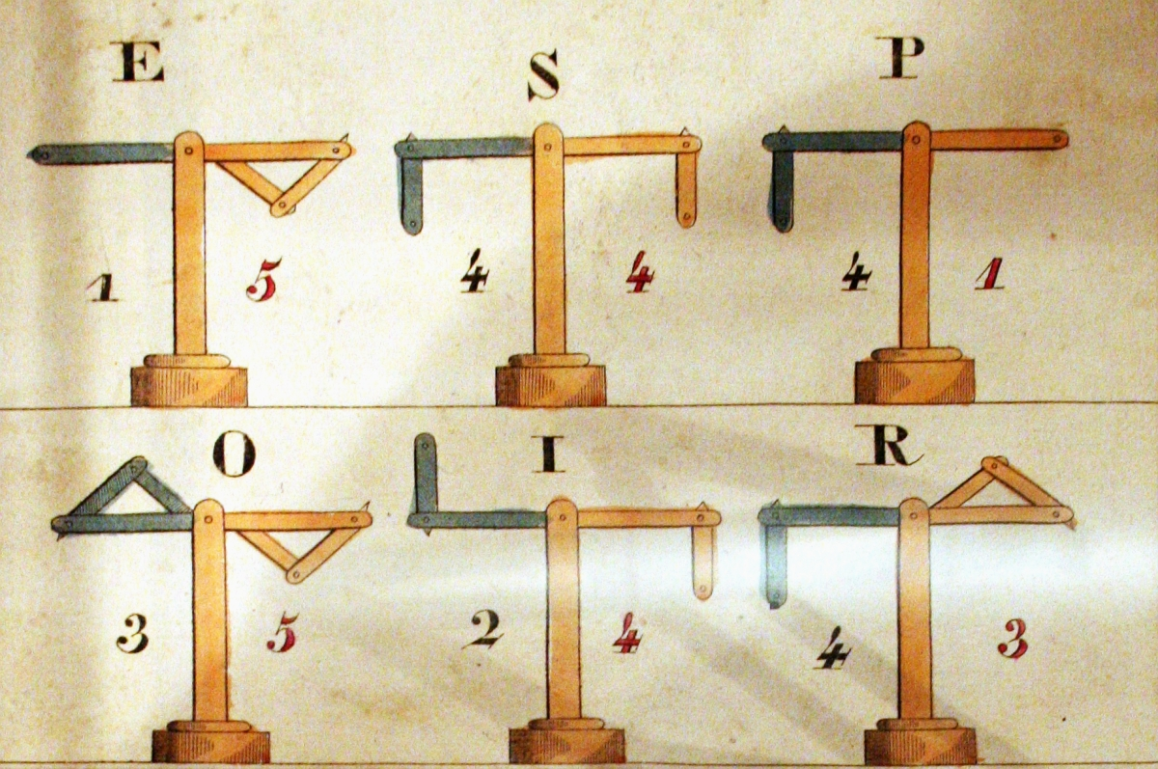
Notes:
The concept of the telegraph was not new—France, where Morse had just been, had an extensive telegraph network. But previous telegraphs were optical: physical features such as arms, flags or lamps were used to signal across long distances. The limitations of optical telegraphy are obvious. The idea of an electromagnetic telegraph had also been pursued for decades, but all the designs were too complex, and people couldn’t solve the practical problems of making a miles-long electrical circuit—another example of that physicality problem I talked about.

Slide 6

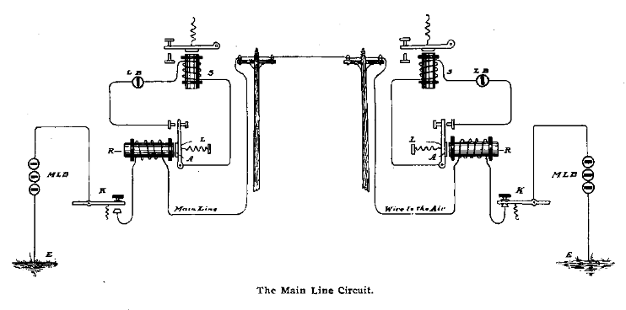

Slide 7

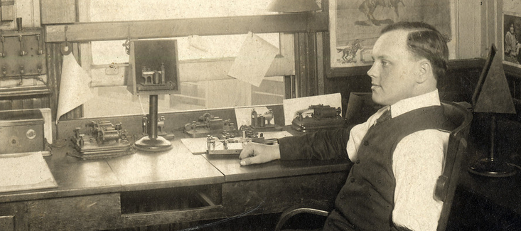
“The dot is an unfortunate appellation for this sign, because it conveys the idea of a point, or to speak electrically, a current of infinitely short duration. Electro-magnets, however, require time in magnetization. Currents involve time in transmitting signals [and] must be of sensible duration. The dot, therefore, involves time, but this time is variable, according to circumstances. The length of the dot should increase with the length of the circuit. In long submarine lines the dot has to be made longer than the dash itself on short open air lines…”
—Modern Practice of the Electric Telegraph, Frank L. Pope, 1881
Notes:
PHYSICALITY
Lines can only run so far. They can have multiple stations along the line, but when they end, they end. The message has to be copied down by someone at the far end, then retransmitted on the next line. This maximum length was 250 or so miles; less in practice, because operating at the limits means less margin to cope with weather. Figure that a message from SF to DC passed through at least 30 hands along the way. So while the best operators could transmit 30 words a minute, you have to multiply that by 30.
Furthermore, imagine that one of those operators is already busy. Messages just pile up until he’s free to send them on. This is buffering, and it results in lag.
The quote here is another example of physicality. Remember that the telegraph operates by turning on electromagnets, and those don’t work instantly—the current has to build up the magnetic field. When the current is weak, it takes longer for the magnet to come on. Go too fast and the device on the far end literally doesn’t work. Telegraph wires were uninsulated (because there wasn’t a cheap solution for insulation; no plastic, and rubber had to be imported from India), so weather would “drain” current from the wire and make everyone slow down.
Here’s a good rule of thumb: You need to worry about the physicality one layer below your preferred level of abstraction. The telegrapher wants to focus on the messages, but needs to worry about the resistance of the wire. The telegraph company wants to focus on delivering telegrams, but needs to worry about the telegraphers.

Slide 8
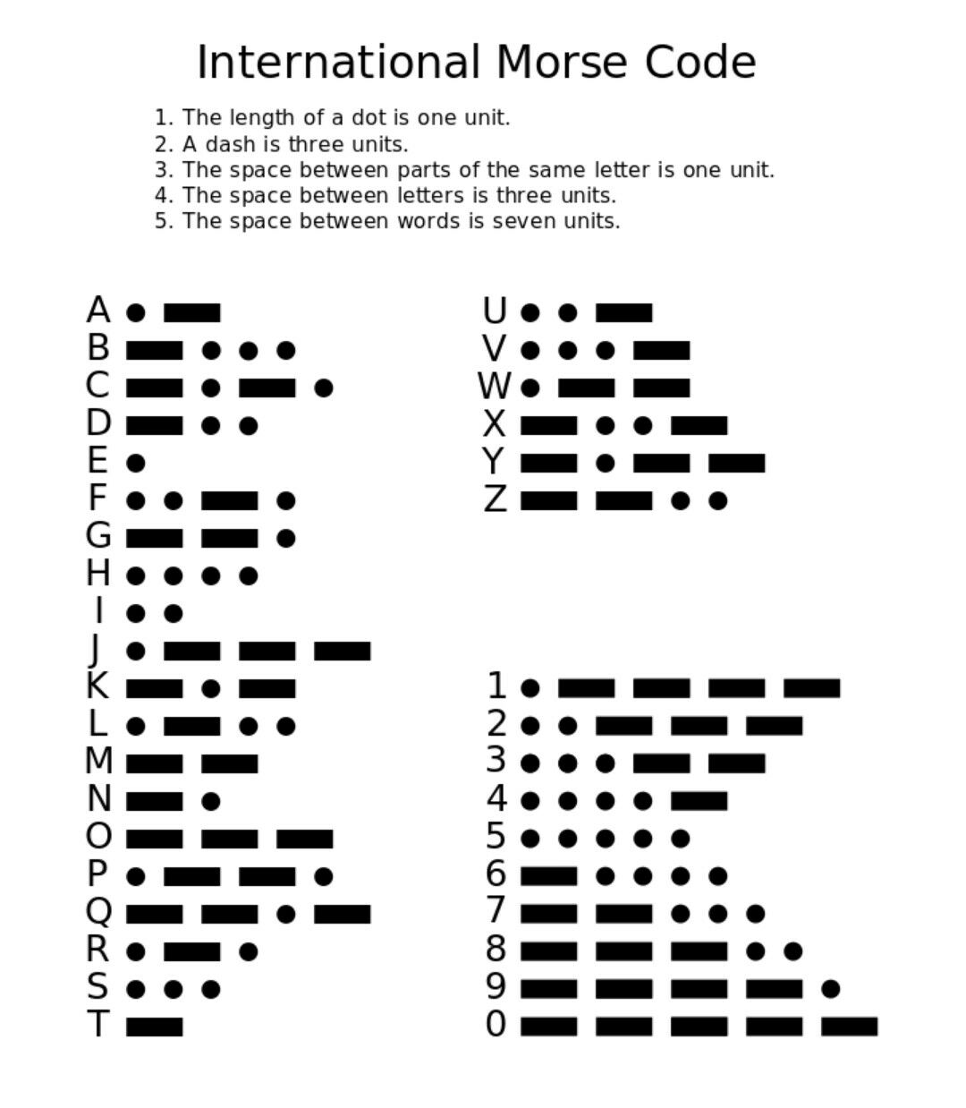
Notes:
But Morse had the virtue of ignorance and just assumed that problem was solved; he focused instead on signalling. His insight was to turn two possible states—on and off—into three possible states, idle, dot and dash, by introducing the element of time. This let him create a very simple and robust prototype that worked over short distances, but those physical problems quickly caught up with him on the long distances. However, he persevered, and by 1838 he had a working long-distance prototype; then the challenge was getting funding, because electrical telegraph inventors were lumped in the same category as perpetual-motion-machine inventors. After another six years, he received funding from the US Congress to run a line from Washington, DC to Baltimore. On May 24, 1844, this line was inaugurated by Morse transmitting the message WHAT HATH GOD WROUGHT.
.-- .... .- - .... .- - .... --. --- -.. .-- .-. --- ..- --. .... -

Slide 9
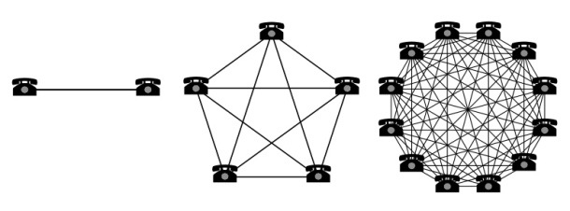
“The value of a network is proportional to the square of the number of connected users of the system.”
–Robert Metcalfe, circa 1980
Notes:
Metcalfe’s Law is credited to Robert Metcalfe, co-inventor of Ethernet and founder of 3Com. It states that the value of a network is proportional to the square of the connected nodes. The reason why is clear: If each connection has equal value, then in a network with n nodes, there are n x n-1 separate connections. Now, this law is demonstrably wrong; I don’t want to get sidetracked onto that here. But it’s right in principle. And it was definitely right in 1844—that one 40-mile line from DC to Baltimore wasn’t worth much. It mostly got used to play chess. [Yes, that’s right, the primary users of the first electrical communications network were online gamers!] But investors saw the potential even if the public and Congress didn’t, and in 1845, the Magnetic Telegraph Company was formed.

Slide 10

1852
1850
1848
1846
1852
Notes:
1846, 40. 1848, 2000. 1850, 12000. 1852, 23000.
In the spring of 1860, cargo-hauling entrepreneurs William Russell, Alexander Majors and William Waddell founded the Pony Express, running mail from St. Joseph, Missouri to San Francisco, California in 10 days. The price was $1 (about $28 today) for a half-ounce letter.
19 months later, on October 24, 1861, a new telegraph line uniting the eastern telegraph network with that of the West Coast went live. This line was operated by the company founded to build it, the Western Union Telegraph Company. Two days later, the Pony Express shut down.
The first telegram was sent from Stephen Field, the chief justice of California, in San Francisco to Lincoln in DC. QUESTION: How long did it take?

Slide 11

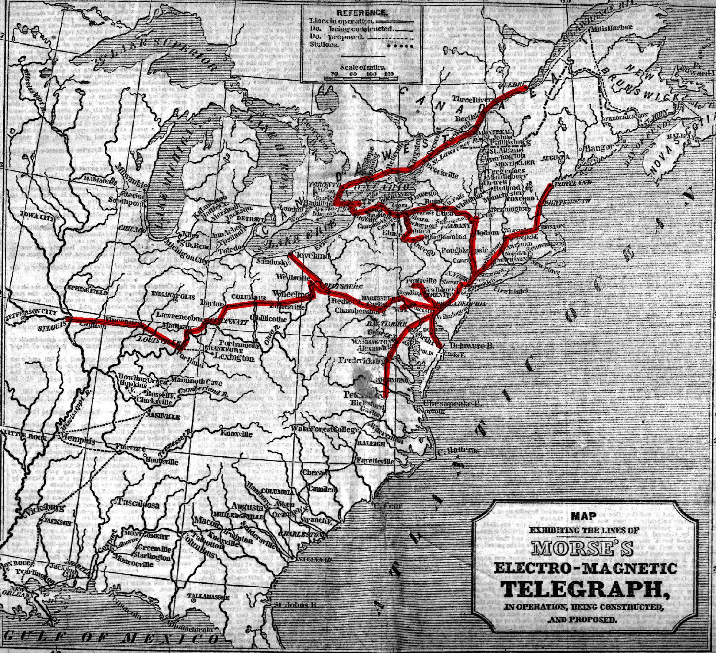
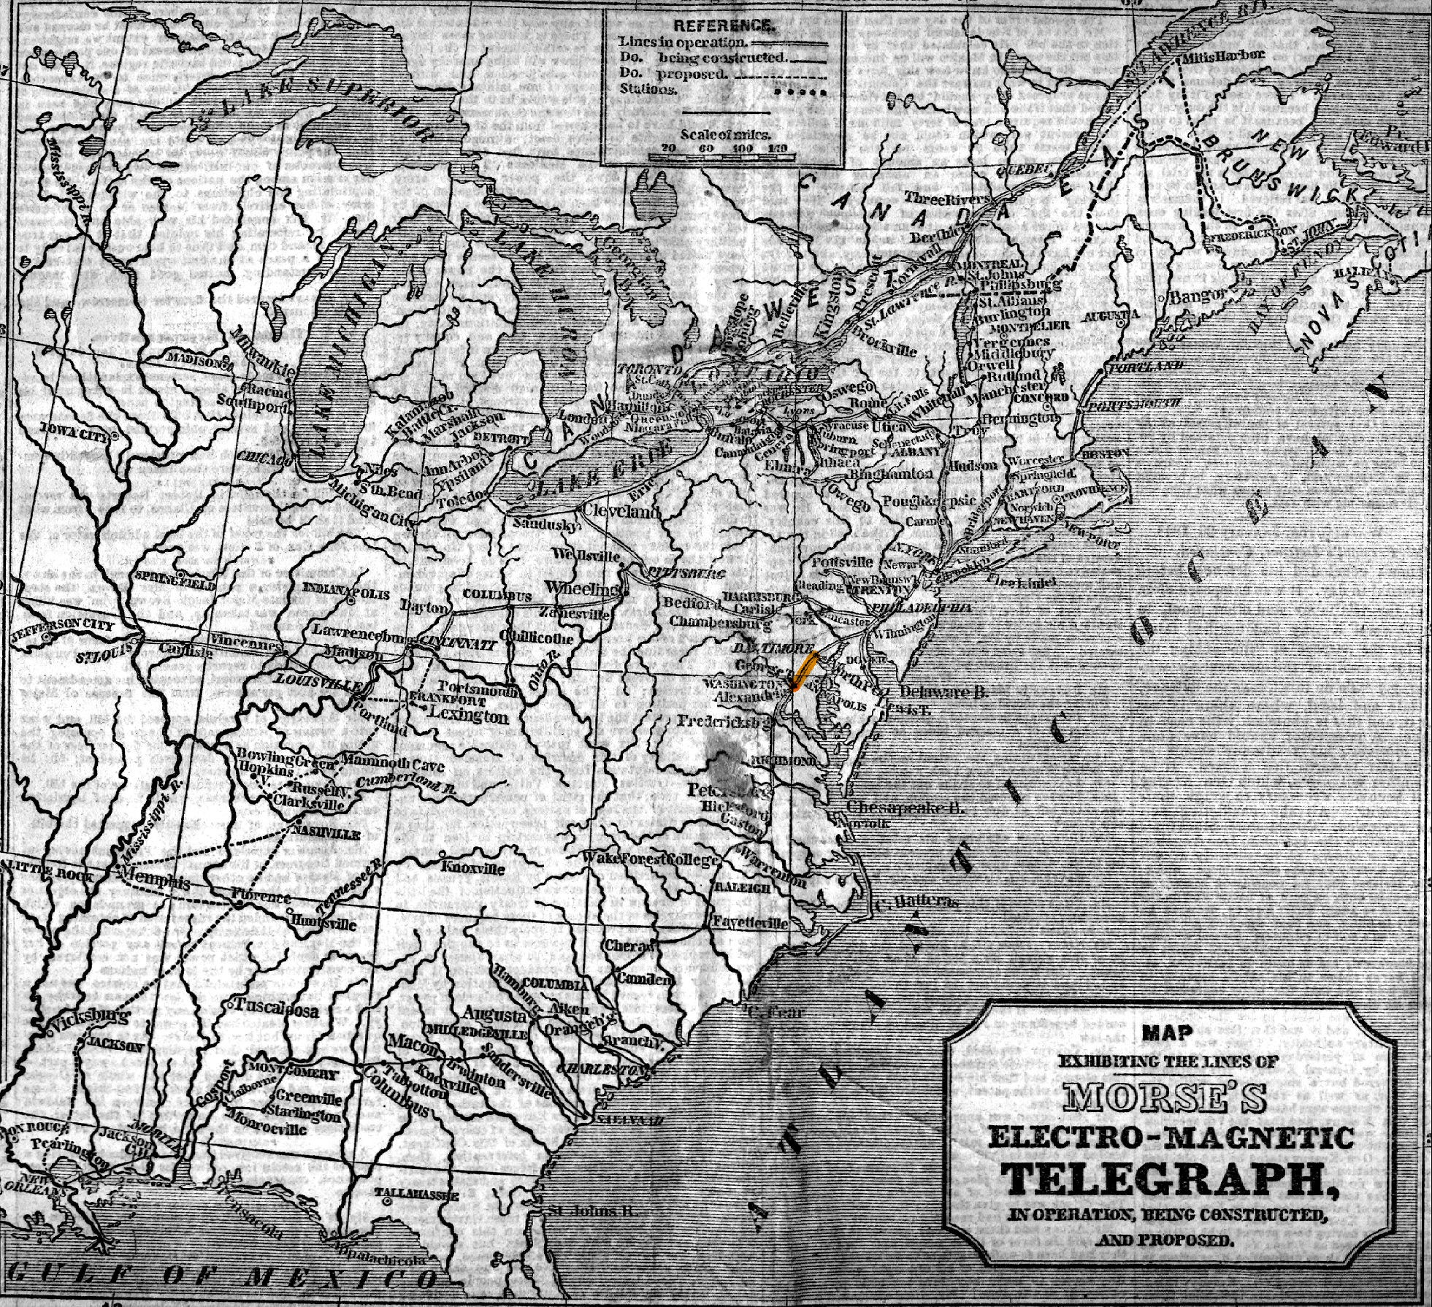
Notes:
Let’s go back to the very early days. Here’s 1846, with our one lonely line, sending chess moves back and forth between DC and Baltimore. Now here’s 1848, right as it’s starting to take off. You can see something interesting here: The telegraph was one of the first times that the topography of a communications network might radically differ from the topography of the transportation network.
Consider sending a message from Cleveland to Buffalo—it had to be sent to Pittsburg, then Philadelphia, then New York, then Albany. Still faster than the 190-mile trip by road or boat, but more importantly it has nothing to do with that 190-mile trip. This is called routing, and it’s critically important for the Internet.
Let’s also take a minute to think about something else: How does the sender in Cleveland know what route to take? For the telegraph, he’d have a book that gave the station name in Buffalo and would list the route to take to it. The Internet uses a different method… in fact, the Internet’s method is unique, remarkable, and defines what the Internet is. We’ll come back to it a little later tonight.

Slide 12

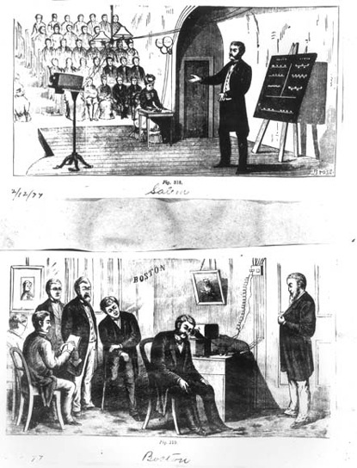

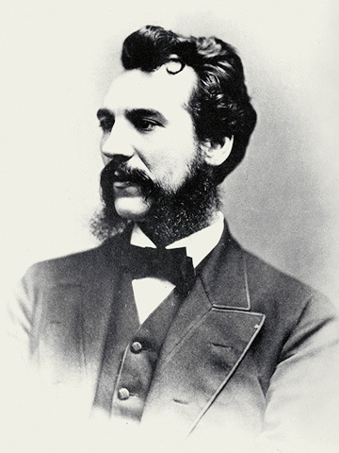
Notes:
Running telegraph wire was very expensive, and demand for telegraphy was massive. Inventors looked for ways to carry multiple telegraph signals across one wire; this was one of the areas where Thomas Edison made his fortune, for example. In 1873, speech therapist and music teacher Alexander Graham Bell envisioned a “harmonic telegraph”, in which separate signals would be sent using separate musical frequencies—using the telegraph wire in basically the same way that an AM or FM radio uses the airwaves. In trying to construct this device, he discovered a way to transmit audio directly. By 1877, the Bell Telephone Company was founded, advertising advantages: no skills required; privacy; 5-10x faster; more reliable. Once again, explosive growth.

Slide 13
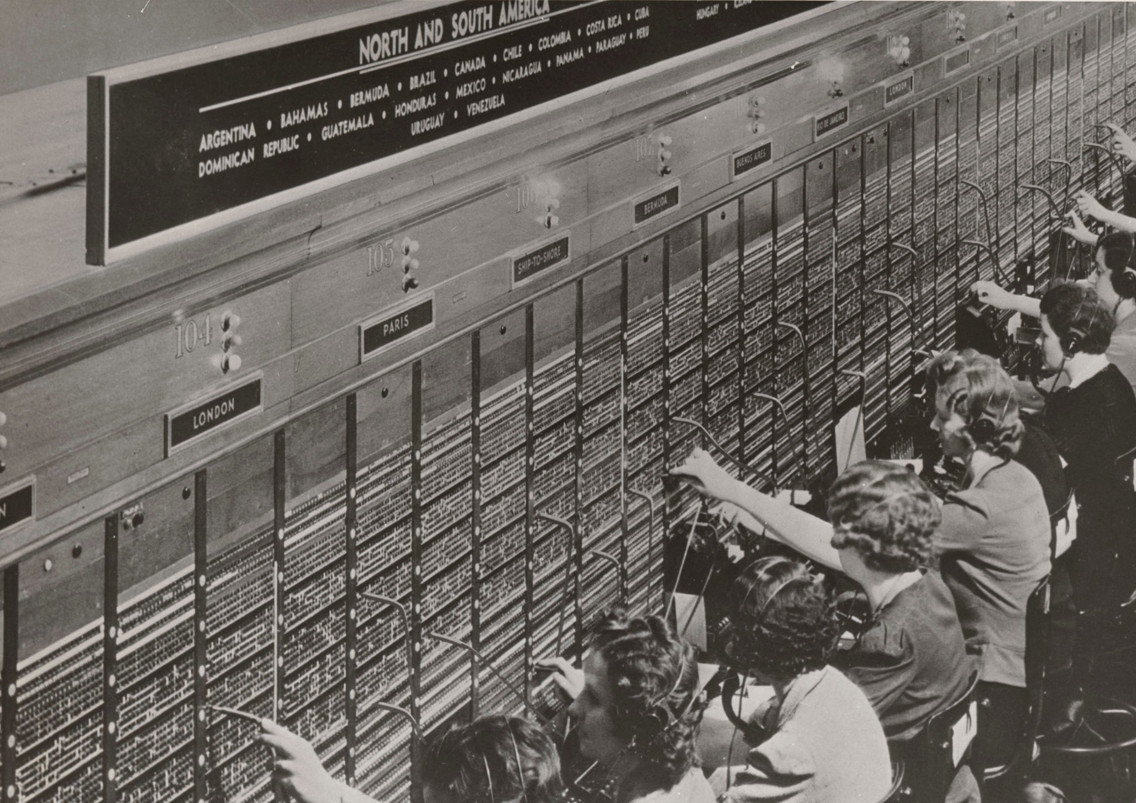
Notes:
It may seem like telephones and telegraphs work the same, but they don’t, in an important way. Telegraphs are packet switched: the connection always exists, and messages (packets) are buffered to use that connection as efficiently as possible. Telephones are (were!) circuit switched: When a call is placed, a series of operators make physical wire connections until one continuous electrical circuit is formed. Packet-switched networks meter by data; circuit-switched networks meter by connection time. Packet switching is more efficient when wire is expensive and computational resources are cheap; circuit switching is better when wire is cheap and computational resources dear. Even traditionally circuit-switched applications like telephony are rapidly moving to packet-switched networks today… but not telegraphs. The world’s last electrical telegraph network, in India, ceased operation in July 2013.

Slide 14

The Victorian Internet
Exponential growth driven by Metcalfe’s Law
Physical constraints are invisible to the operator but manifest in other ways:
Message buffering and lag
Message routing
Packet switching is the basis of all modern networks
Just-for-fun reading: The Victorian Internet by Tom Standage (ISBN 0802716040)
Notes:
That last one is a good book, but it won’t be on the test. Read it over the winter break. :)
DISCUSSION: I said Metcalfe’s Law was wrong. Why’d I say that? Am I right?
“We are in great haste to construct a magnetic telegraph from Maine to Texas; but Maine and Texas, it may be, have nothing important to communicate.” —Henry David Thoreau, Walden, 1854
If Metcalfe’s Law were true, there’d be overwhelming pressure to interconnect networks regardless of their relative sizes.
Zipf’s Law: however you rank a list, the kth-ranked element will be about 1/kth the first. (Ex: The most common English word, the, is 7% of all text. Next is of, at 3.5%. Third is and, at 2.8%.) So if we rank the contribution of each member of the network, 1 + 1/2 + 1/3 + … + 1/(n-1), then the value to each member of the network approaches log(n), and the overall value is therefore closer to n log n.
[source http://spectrum.ieee.org/computing/networks/metcalfes-law-is-wrong]

Slide 15
